Slide 1
PPT Summary:
DASHBOARD DESIGN
By Aatika Amir: Data Analyst Intern
Notes:
Ppt summary of Sales,profit and Sales Growth Analysis (tableau Dashboard)

Slide 2
Dashboard
Overview
• KPIs: Total Sales & Total Profit
• Sales Growth Line Chart included
• Category filter (slicer) added for interactivity
• Consistent color theme applied
• Navigation buttons link to explanation dashboards
Navigation menu
Notes:
This slide shows the main dashboard with KPIs for Sales and Profit, a Sales Growth line chart, and category filter for interactivity. Navigation buttons allow the user to view explanation dashboards for each KPI.
Also added the navigation menu of individual sheets easy for the viewer to open each sheet

Slide 3
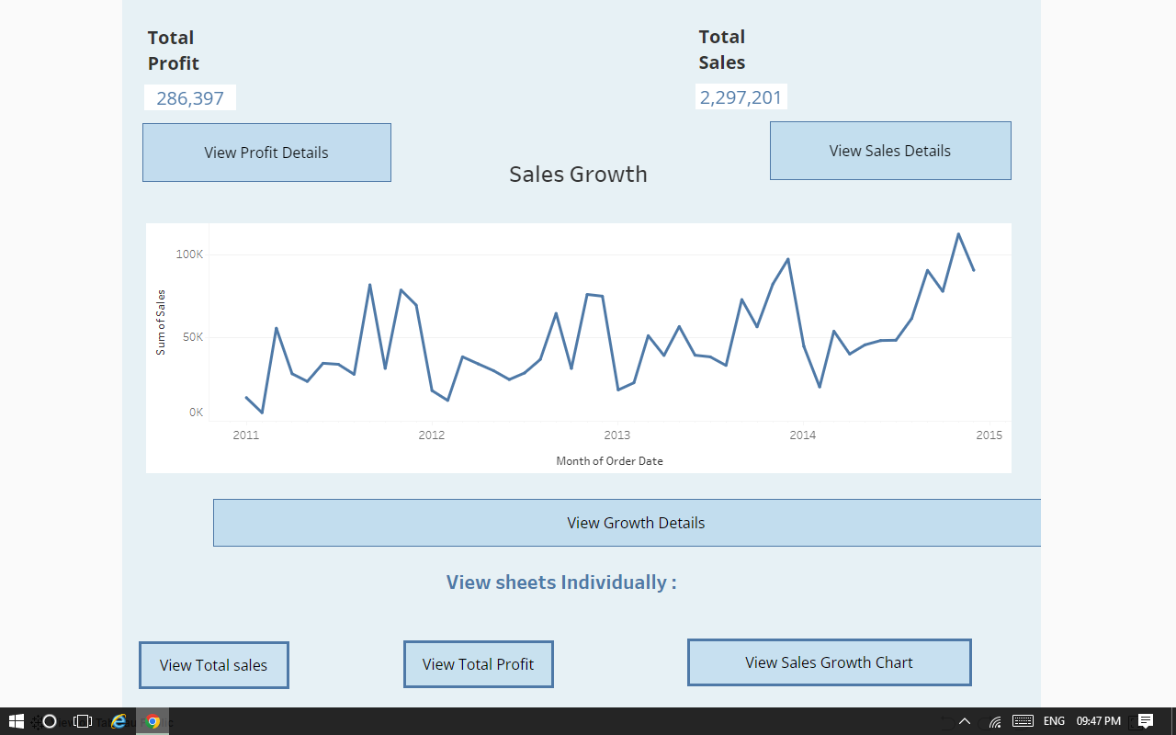
Dashboard Screenshots

Slide 4
Sales Summary
insights:
• Total Sales represent overall revenue
• KPI shows revenue at a glance
• Line chart shows sales trend over time
• Conclusion: Sales performance is stable and shows growth
• Helps identify high-performing months

Slide 5
Profit Summary
Insights:
• Total Profit shows earnings after costs
• KPI highlights overall profitability
• Line chart identifies high-profit periods
• Conclusion: Business is profitable and stable
• Helps plan strategies for improving earnings

Slide 6
Sales Growth /Time series
Insights:
• Shows trend of sales over time
• Line chart highlights growth or decline periods • Helps identify seasonality in sales.
• Supports data-driven decision making
• Conclusion: Overall sales are increasing steadily

Slide 7
NAVIGATION & INTERACTIVITY

Slide 8
NAVIGATION MENU
Navigation Button
Insights:
• Each KPI and chart has a navigation button
• Buttons link to separate explanation dashboards (Sales, Profit, Growth)
• Back button returns to Original Dashboard • Fully interactive for the user
• Supports easy exploration of insights
This slide explains the navigation buttons that link KPIs and charts to their respective explanation dashboards, allowing smooth interactive exploration.

Slide 9
CONCLUSION & KEY INSIGHTS:
Total sales:
Total Sales are stable and show consistent growth over time
Total profit:
Total Profit indicates a profitable business with high-earning periods
Sales growth (chart):
Sales Growth line chart highlights trends and seasonality

Slide 10
THANK YOU
Thank you for reviewing my Tableau Dashboard project. Interactive insights on Sales, Profit, and Growth are included.

